Slide 1
UEN002 – Energy and Environment
In the previous session, we went through…..
……the functional elements of MSW management,
  ……the scenario of MSW Management in India and abroad

Slide 2
Energy Recovery from SW
Processing and recovery
Management strategies
  Incineration/Pyrolysis
  Composting
Incineration
  Controlled combustion process for burning SWM
  Heat value of typical MSW – 8.8 kcal/kg (coal – 545 kcal/kg)
  Problematic components of incineration – particulate dust, sulphur and nitrogen oxides, chlorine compounds, hydrocarbons
  APCDs for control measures

Slide 3
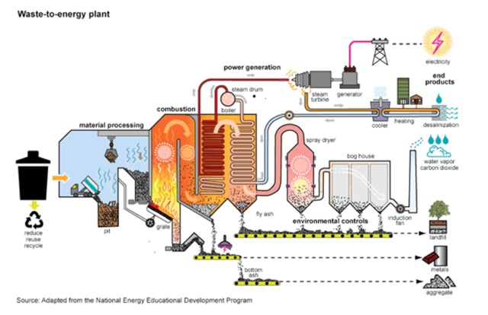
Incineration of MSW
Heat recovery efficiency – 70%
Amount of steam produced varies from 1.0 to 3.5 kg/kg of MSW

Slide 4
Incineration of MSW
Incineration is defined as controlled burning of solid, liquid or gaseous wastes
Why controlled burning?
The primary purpose of the incineration is volume reduction
Practically 50-60% of volume reduction can be achieved with incineration
Incinerated waste occupies only a fraction of the landfill when compared to the un-incinerated waste

Slide 5
Incineration of MSW
Second purpose of incineration is conversion of waste to energy
Dependent upon the heat value of MSW
Third purpose is detoxification
Heterogenous nature of MSW results in assortment of residues during incineration which require additional processing and disposal
  Acidic gases such as SOx, NOx and HCl
  Trace gases (ex. Chlorinated dibenzodioxins) which are hazardous
  Particulate matter (fly ash) and residual matter (bottom ash)
  Process water

Slide 6
Incineration of MSW
Combustion concepts
Aerobic thermal destruction process
Efficient combustion with minimum air pollutant emissions requires primarily stoichiometric air that takes combustion reactions to completion and avoid generation of any products of incomplete combustion
In combustion of an organic matter in MSW, the presumed reaction is
(HC)_{x} + O₂ -------→ CO₂ + H₂O + Heat
However, not all hydrocarbons convert to carbondioxide and impurities such as sulphur, nitrogen, etc influence the incineration process

Slide 7
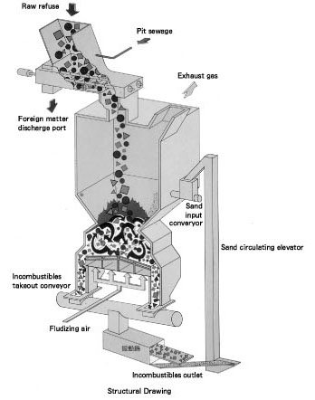
Fluidized bed incinerator

Slide 8
Incineration of MSW
factors influencing complete combustion include
  Temperature : Each combustible substance has minimum ignition temperature that must be attained in the presence of oxygen for combustion to be sustained
  Time : The residence time of the input waste in the high temperature region of the combustion zone should exceed the time required for combustion
  Turbulence: Through mixing of MSW as it passes through the combustion chamber

Slide 9
Waste Incineration - Advantages
Volume and weight reduced (approx. 90% vol. and 75% wt reduction)
Waste reduction is immediate, no long term residency required
Destruction in seconds where LF requires 100s of years
Incineration can be done at generation site
Air discharges can be controlled
Ash residue is usually non-putrescible, sterile, inert
Small disposal area required
Cost can be offset by heat recovery/ sale of energy

Slide 10
Waste Incineration - Disadvantages
High capital cost
Skilled operators are required (particularly for boiler operations)
Some materials are noncombustible
Some material require supplemental fuel

Slide 11
Gasification and Pyrolysis
Recovers
  synthesis gas (Hydrogen, Methane, Ammonia and Carbon oxides),
  utilizable glass-like minerals,
  metals rich in iron and sulfur
….from municipal solid waste
It involves two steps (1) high temperature gasification of the organic waste constituents and (2) direct fusion of the inorganic components.
…and (3) Recovery of usable raw materials during the process water treatment suchas pure water, salt and zinc concentrate.
No ashes, slag or filter dusts

Slide 12
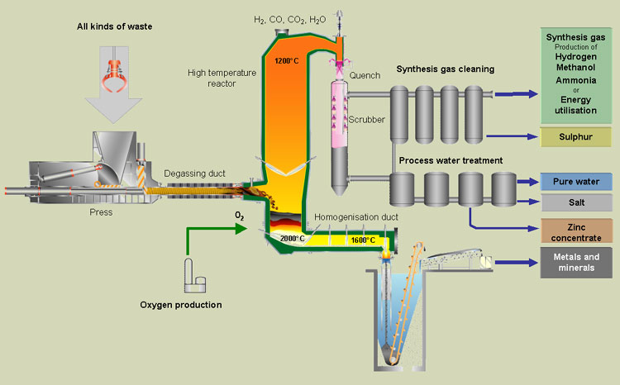
Gasification Process

Slide 13
Pyrolysis
  Organic material – long-chain hydrocarbons
  Generates heat value products such as gas and liquid
  Low oxygen process for release of chemical energy
  Less use because of high capital investment and low waste seggregation practices
Charcoal/bitumen - upto 35% yield
Pyrolysis
Bio-oil - upto 80% yield
Flash pyrolysis, low temperature
Fuel gas - upto 80% yield
Flash pyrolysis, high temperature

Slide 14
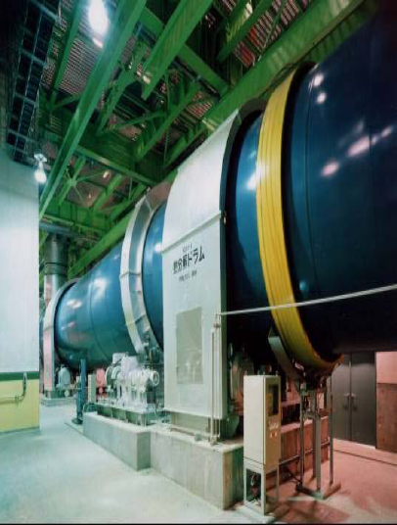
Pyrolyzer—Mitsui R21

Slide 15
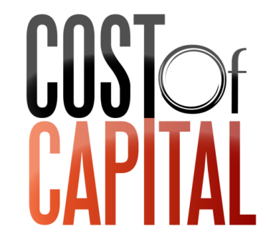








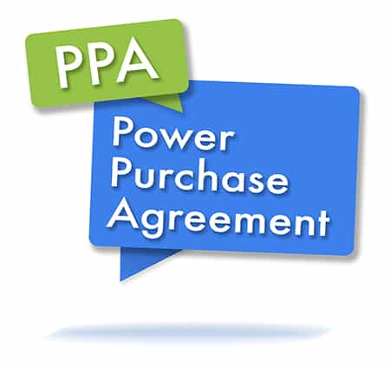
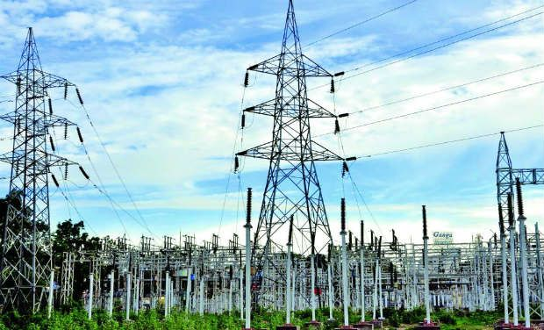
Municipalities
State Government
Central Government

Slide 16
In the next……
You will be introduced to
  Aerobic composting of Biodegradable solid waste

